Slide 1
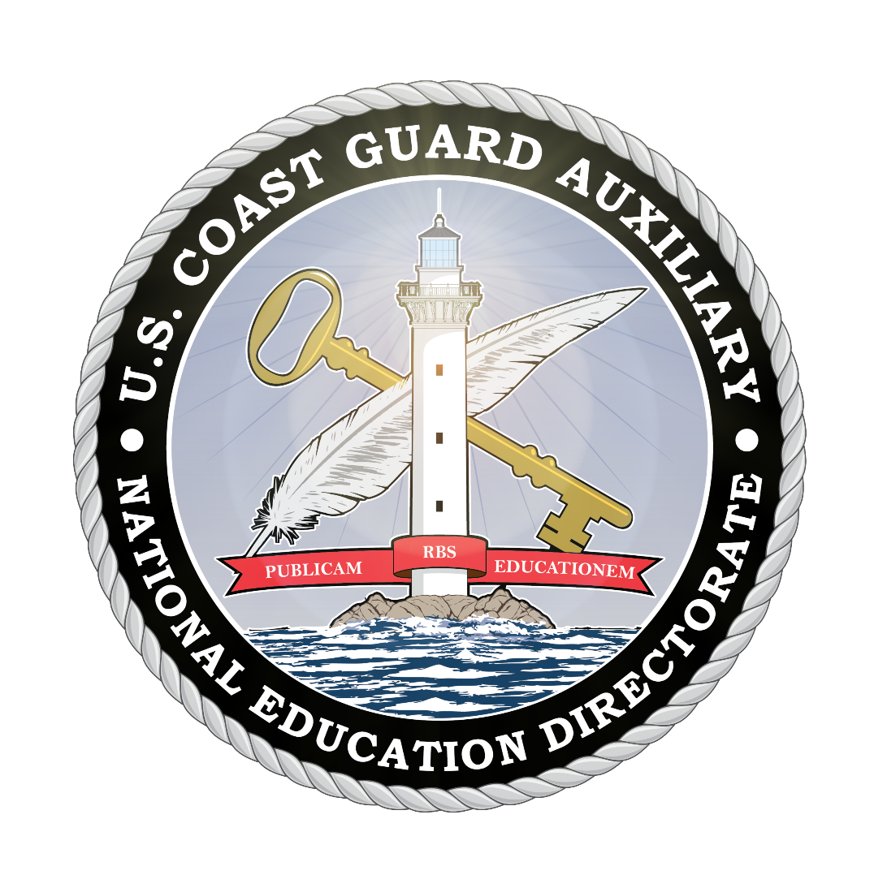
National Public Education Directorate Instructor Workshop 2022
January 2022
Notes:
This is the mandatory Instructor Workshop for 2022. Members can read the material and submit a self-attestation form or the material can be presented by a qualified facilitator.

Slide 2
Welcome
Key Points:
E-Directorate Website Navigation
Virtual Classes via Videoconferencing
RBS Committees - Marketing PE Classes
Instructor Development 2020
Maxim Award
Boat America
Spanish Language Classes
How-to for a PE Officer
Recertifying after REYR
Uniforms
What’s New
Notes:
This workshop is designed to assist all members involved with Public Education: Staff Officers for Public Education at all levels, Instructors, and their elected officers. The material in this presentation will provide the member with ways to improve class presentations and take advantage of the material on the Public Education Directorate website.
Emphasis will be on the items listed, including:
E-Directorate Website Navigation – the pages have been reorganized and enhanced. The Public Education Directorate is constantly adding new material to the website. Members are encouraged to regularly check the What’s New section on the left menu of the Home Page.
Virtual Classes via Videoconferencing – this will cover the current state of affairs relative to the offering of virtual classes
RBS Committees – Marketing Our Classes – this area will provide some concrete suggestions for marketing our PE classes by forming flotilla RBS committees
Instructor Development 2020 – this section will introduce the ID2020 program and the related Performance Qualification Standard (PQS)
Maxim Award – the Maxim Award winners for the 2020 activity have been selected and announced. It’s now time to get the 2021 packages in
Boat America – Review of Boat America resources
Spanish Language Classes – when reviewing boating accident and fatality statistics it became apparent that the Hispanic and Latin population was underserved. The E-Directorate has responded with several translations
How-to for a PE Officer – many Flotilla Staff Officers-Public Education are new to the position. This section will present an overview of what resources are available on the E-Directorate website.
Recertifying after REYR – if an instructor has gone REYR (Yearly Requirement Not Met0, here are instructions on how to re-certify.
Proper uniforms for Public Education Classes
What’s New – new information on ECOS and Fire Extinguishers

Slide 3
E-Directorate Missions
Provide exceptional boating education to:
Reduce:
Loss of life
Personal injury
Property damage
Provide timely materials to:
Support:
Instructors
Public Education Staff Officers
Notes:
The mission of the Public Education Directorate of the US Coast Guard Auxiliary is two-fold: to provide exceptional boating safety education to the American public to reduce loss of life, personal injury, and property damage to recreational boaters; and to deliver the highest possible quality training, resources, and timely materials in support of our flotilla instructors and public education staff officers at every level who are furnishing such boating safety education.
The Public Education Directorate is committed to focusing its attention on helping realize those goals by reaching as many people with safe boating information as possible, especially the high-risk boaters.
In addition, we have these goals:
Develop and/or maintain up-to-date and effective educational materials;
Continue to focus on the segment of the boating public most at risk Increase flotilla-taught basic boating safety education by at least 10% annually;
Provide and promote ongoing quality instructor development;
Make use of appropriate technological resources;
Adopt e-learning as a viable way to reach boaters;
Utilize e-learning to challenge and grow our instructor corps;
Partner with outside organizations where applicable to further boating education;
Continue to team with the experience and expertise of the other National Departments to provide solid programs and course

Slide 4
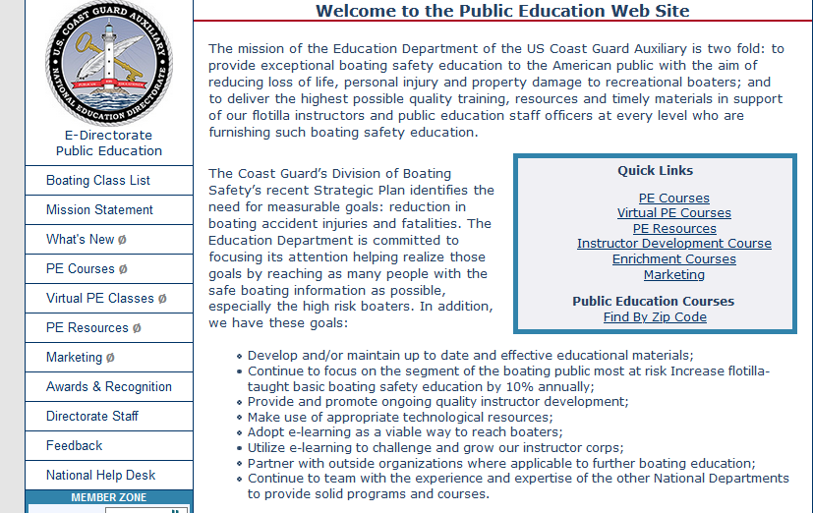
Website Navigation
Reordered menu
Intuitive navigation
Fewer clicks
Archiving of old material
Frequent material updates
http://wow.uscgaux.info/content.php?unit=e-dept
Notes:
E-Directorate website refresh and reorganization were completed in 2021. Reorder of menu choices enables users to find what they need more intuitively and with fewer clicks. Older material has been archived.
Since public education is such a dynamic area, there are constant additions made to the website. It is really worthwhile for the Instructor and Staff Officer to check the site frequently – especially the What’s New section.

Slide 5
Virtual Classes via Videoconferencing
Visit the E-Directorate Virtual PE Classes Web Pages
In Member Zone protected pages
Describes:
Value of virtual classes
How-to of virtual classes
Marketing of virtual classes
http://wow.uscgaux.info/content.php?unit=E-DEPT&category=virtual-pe-classes
Notes:
The workshop attendee is encouraged to check out the information and resources available in the Virtual PE Classes menu on the left side of the page. The information is protected from the public by being in the member zone. Log in with the same login you use for most of your Auxiliary areas (user name = member number; password = unique to each user)
With the advent of the COVID-19 pandemic in 2020 and the subsequent shutdown of Auxiliary missions, the E-Directorate quickly embraced the virtual technology to enable the members to continue instructing public education classes within the RBS mission area.

Slide 6
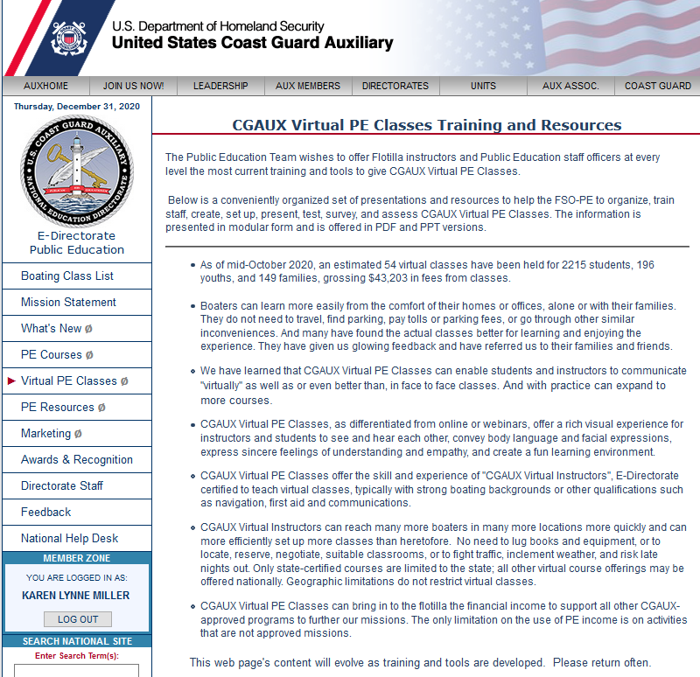
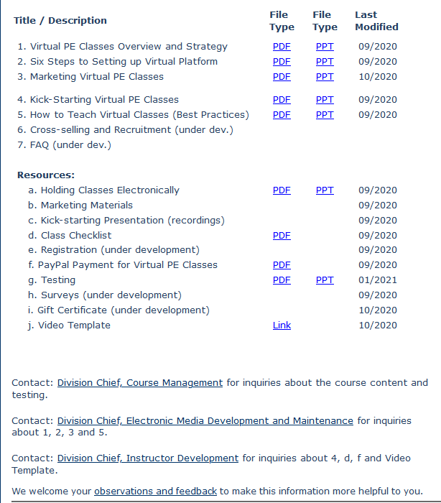
Virtual Classes via Videoconferencing
Visit the E-Directorate Virtual PE Classes Web Page
http://wow.uscgaux.info/content.php?unit=E-DEPT&category=virtual-pe-classes
Notes:
The virtual PE web page contains valuable information on the rationale for offering classes online via videoconferencing. In addition, there are numerous tools to help the FSOs-PE and instructors set up the virtual platform, kick-start the whole process of offering virtual classes, collecting class fees using PayPal, conducting “proctored” testing in a virtual environment, and marketing the classes even during these difficult times.
Even as we open up classes more and more to in-person sessions, FSOs-PE may want to consider continuing to offer some of their classes via videoconferencing. With almost two years of experience, many flotillas are experiencing more students enrolling in virtual classes than they had in face-to-face classes. The virtual class eliminates the commuting requirements for the students and instructors and vastly opens the area from which we can attract students.
Students are now connecting virtually from across the state(s) and are no longer limited to driving distance. Families are taking virtual classes together from the comfort of their homes. And students enjoy the interaction of seeing each other and the instructors on the video screen.

Slide 7
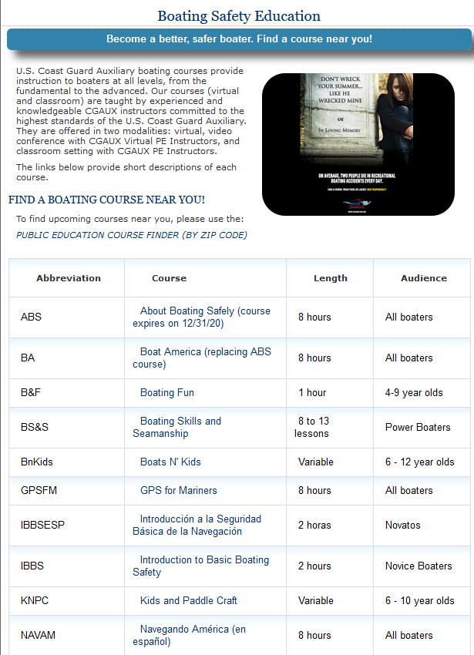
Course Finder
Refreshed/Re-organized Course Finder
www.cgaux.org/boatinged/class_finder/index.php
Notes:
Completely updated and reorganized the Course Finder to include certificate courses and seminars. This will allow flotillas to advertise all Auxiliary classes they offer. It is now possible to advertise that a class is virtual and not an in-person classroom class.
This site is updated via the Form Warehouse, ANSC Form 7023. As soon as possible the FSO-PE or other officer should populate their classes for the year. It’s essentially free advertising. A lot of the individual states link right back to this page when referring boaters to classes.

Slide 8
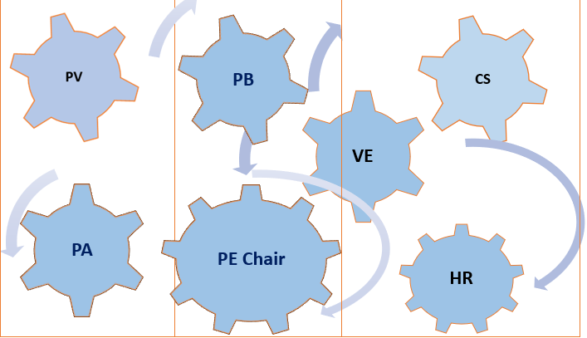
RBS Committees
A smoothly functioning team of flotilla staff officers can achieve significant results with coordinated teamwork
Notes:
Referrals are traditionally the best source of new students. The best time to find out about our classes is when boaters are making a boating-related decision. Many service providers can benefit their clients by recommending CGAUX PE Classes.
Building relationships with those vendors can pay off with a steady stream of referrals. And if the relationship is cultivated, it keeps on giving, and it builds upon itself year after year. Formal and informal referrals can be repetitive and cumulative, low cost, and very rewarding.
A smoothly functioning team of flotilla staff officers can achieve significant results with coordinated teamwork. A clear website, a rich calendar with frequent multiple offerings, active Facebook friends, a targeted video, special interest articles with local community papers, local TV interviews, local radio, boating, fishing hunting programs, and public service ads, all these offer steady opportunities. And, above all, a friction-less signup procedure where a knowledgeable Auxiliarist answers all inquiries personally and quickly, enrolling the inquiring boater seamlessly.
The Public Education Directorate webpage has several good presentations on marketing your PE programs – both Outbound (i.e., PA) and Inbound (i.e., referrals).

Slide 9
Instructor Development 2020
Updated material and exam
Introduced in January 2020
New instruction techniques
Emphasis on learning vis-à-vis memorization
Includes:
Use of electronic media
Compliance with ADA
Value and use of lesson plans
http://wow.uscgaux.info/content.php?unit=E-DEPT&category=2020-instructor-dev
Notes:
Before this updated program, the Instructor Development course had not been modernized since 2007. A lot has happened during that time to help the Auxiliary instructor perfect their presentation methods. This course – ID2020 – does that. This course is recommended for both initial qualification as well as a refresher for seasoned instructors.
The course has eight units with an emphasis on learning the information through practical application rather than memorizing theoretical instructor material. The units include:
14 instructor competencies
Lesson planning
Using Media Effectively
Effective Communications Skills
Handling Difficult situations
Accommodating all students
Learning with Electronic Technologies
There are also several appendices:
Instructional equipment
Presentation tips and best practices
The performance qualification standard
It is highly recommended that even seasoned instructors review the ID2020 Student Study Guide and then go to NTC and take the new exam. There’s a lot to be learned this way.

Slide 10
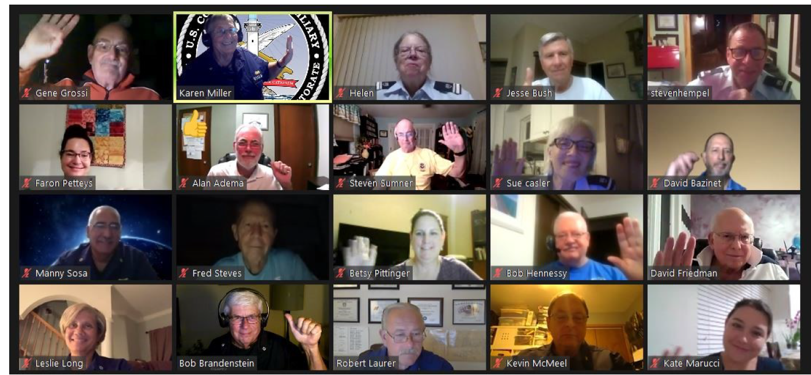
Instructor Development 2020
Nation-wide Virtual ID2020 Class
Notes:
The completion and deployment of Instructor Development 2020 prepares new instructors not just for public education, but also qualifies them for member training to help address an ever-shrinking cadre of instructors.
Uniquely, the E Directorate conducted a series of virtual classes to qualify new instructors online. The students completed all PQS tasks except for the final 2-hour presentation which they completed with their own flotillas. The final sign-offs and certifications were completed at the flotilla level. The upside of completing their certifications in a virtual environment ensured each student was comfortable and competent using this technology to teach public education and member training.
Feedback received has been outstanding with no negative comments. This method could work very well at a local level – in a district, division, or flotilla.

Slide 11
Maxim Award
Designed to:
Motivate instructors
To achieve excellence in instruction
Develop innovative methods and training aids
Increase mentorship
Nominated by flotilla no later than February 28th
http://wow.uscgaux.info/content.php?unit=E-DEPT&category=maxim-award
Notes:
The Commodore Daniel Maxim Award for Excellence in Education was established to motivate and inspire the entire Instructor cadre to reach beyond the comfortable or ordinary to achieve the extraordinary. Some of the goals of the Award are to increase the diversity of courses offered by flotillas and additional numbers of classes offered; to improve Public Education and Member Training Instructor effectiveness and performance; to improve mentorship of newer or lesser experienced Instructors; to develop new and innovative teaching methods and techniques; and to develop new and innovative teaching aids.

Slide 12
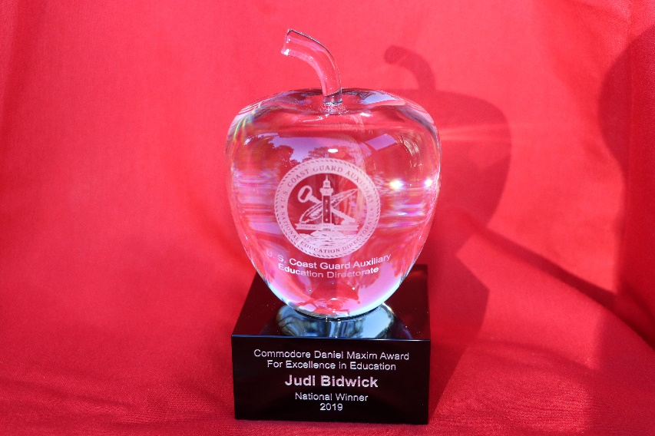
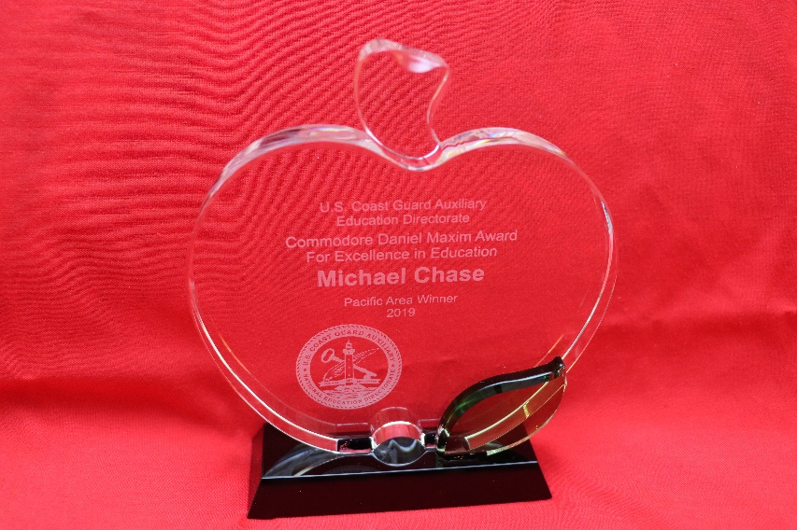
Maxim Award
National Prize Winner + Auxiliary Commendation Medal
Area Prize Winner + Auxiliary Achievement Medal
Notes:
Flotillas should consider assembling a team now to begin accumulating supporting documentation for the numbers of courses taught, numbers of graduates, variety of courses taught, and all other data and testimonials deemed pertinent to preparing the nominee package. Flotilla nomination packages will be due on February 28 to their division, so now is the time to start in order to avoid the last-minute rush as that date will be here before we know it!
The Public Education Directorate recognizes that 2021 was an especially challenging year for most Auxiliarists because of COVID-19 precautions. However, many flotillas openly embraced the option of offering virtual online classes via videoconferencing, and nomination packages should include how the nominee overcame the obstacles of using new technology for course presentation and what successes s/he experienced.
Go to http://wow.uscgaux.info/content.php?unit=E-DEPT&category=maxim-award for more information on the Commodore Daniel Maxim Award for Excellence in Education.
NOTE: Schedule
Package from flotillas to division: 28Feb
Division selected package to district: 31Mar
District selected package to Dir-E and Dir-Ed: 30Apr
NOTE: Eligibility
All instructors in the CG Auxiliary are eligible if nominated for the Maxim Award except a prior National Prize Winner or a member of the Public Education Directorate

Slide 13
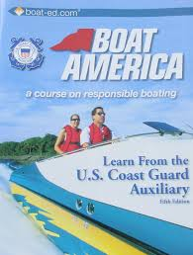
Boat America
Boat America offered as NASBLA approved certificate course
Order from AUXCEN (Shop Auxiliary)
https://auxcen.com/public-education/
Find the slides with instructor notes and the state supplement slides at:
http://wow.uscgaux.info/content.php?unit=E-DEPT&category=nasbla-courses
Notes:
About Boating Safely, our mainstay eight-hour, public education course reached its end-of-life for NASBLA approval on June 30, 2021. It no longer qualifies as a NASBLA approved certificate course.
The E-Directorate found an excellent replacement in Boat America and encourages flotillas to embrace this newer course. The slides and instructor notes are included on the E-Directorate website under a Member Zone-protected section titled PE Courses. There is also a DVD available from AUXCEN that includes numerous videos to incorporate into the course presentation.
The state supplements remain and are used without change for Boat America and Boating Skills and Seamanship, thus ensuring a seamless transition and ease of use for flotillas teaching these certificate courses. Whenever a state requests changes to their slides and/or test, the Division Chief for Course Development will implement the updates and then notify the appropriate DSO-PE who should, in turn, pass the information down to the SOs-PE and FSOs-PE.
Flotillas are encouraged to add to the slides any appropriate material that will enhance the presentation and make it applicable to the local area. Just remember, you can’t delete material but can add appropriate items to better explain a point, such as additional slides, videos, etc.
This course works well for both in-person delivery and via virtual platforms.

Slide 14
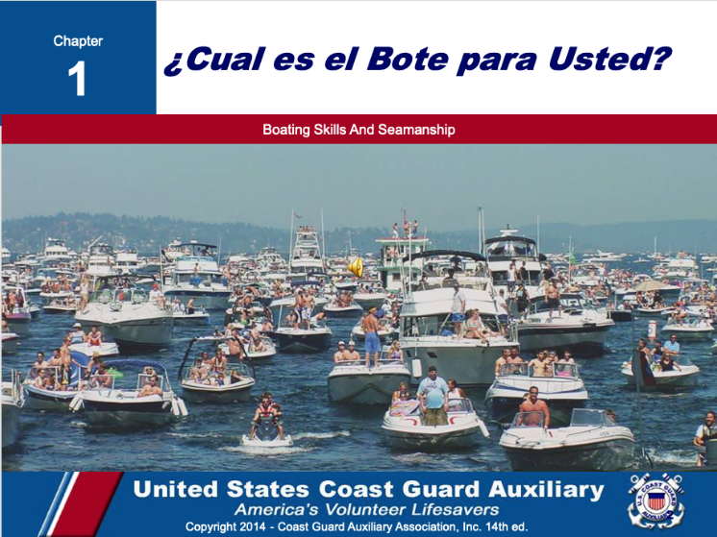
Spanish Language Classes
Spanish-speaking boaters:
Represent fast-growing boat buyers
Emerging market of first-time boat buyers
Under-served boating education market
http://wow.uscgaux.info/content.php?unit=E-DEPT&category=pe-courses
Notes:
A 2017 study published by the National Marine Manufacturers Association, Recreational Boating & Fishing Foundation, and Discover Boating showed that Spanish-speaking boaters represent a fast-growing, emerging market of first-time boat buyers. In response, the E-Directorate is rolling out a series of courses translated into Spanish. All supplemental material – PowerPoint Slides, Instructor Notes, and Final Exams are all in Spanish; the textbooks will remain in English.
These Spanish language courses can be found on the Public Education website on the left menu under PE Courses (protected by the Member Zone password). There are both NASBLA courses and Seminar Courses in that area.
Boat America
Boating Skills and Seamanship
Introduction to Basic Boating Safety

Slide 15
Spanish Language Classes
All slides, instructor notes, and exams in Spanish - books are offered only in English
Notes:
A team of bi-lingual CG Auxiliary members converted all of the Boat America and Boating Skills and Seamanship slides, instructor notes and examinations into the Spanish language. This effort is intended to help educate members of the Hispanic community in safe boating through their native language.

Slide 16
I’m the Flotilla Staff Officer-Public Education, Now What?
Available on the E-Directorate Website
Notes:
One of the most important missions we have is the offering of safe boating classes to the recreational boating public. This new training course is designed for both the new Flotilla Staff Officer-Public Education (known as FSO-PE) and for those returning to the position and who want to learn best practices. Sit back, grab the helm, put on your life jacket, and attach the engine cutoff switch. Enjoy the ride!
Whether you volunteered for this important flotilla staff position or had left the room and were “volun-told” upon your return, the FSO-PE position is critical to the Coast Guard Auxiliary’s Recreational Boating Safety mission and to the flotilla’s finances.
The FSO-PE position can be a pathway to even more responsible positions. Once a member has mastered the Flotilla Position, there’s the Division Staff Officer, Assistant District Staff Officer, and even District Staff Officer. Each position is a learning experience and can prepare the member to advance to more responsibility.

Slide 17
I’m the Flotilla Staff Officer-Public Education, Now What?
General FSO-PE Job Description
FSO-PE - Public Education: Exercise staff responsibility and supervision over all matters pertaining to the public education program, which includes the scheduling, organization and conduct of flotilla public education activities; and keep flotilla members informed of all developments in the program. Unless otherwise directed, you are to schedule qualified Auxiliarists to perform specific activities in support of the public education program. The schedule must include a specified time and place for the activity. Maintain close liaison with the Division Public Education Staff Officer (SO-PE) in order to implement the public education programs established for nation-wide, district-wide and division-wide use. Coordinate and cooperate with the Flotilla Member Training Officer (FSO-MT) to increase the number of qualified instructors. Maintain a close contact with flotilla instructors to encourage increased activity, and maintenance of uniformly high standards. Forward to the SO-PE such methods, training aid, course materials, or other educational tools developed within the flotilla that may have division-wide application.
Notes:
As the FSO-PE you:
Supervise and schedule qualified Auxiliarists to perform specific activities in support of the Public Education Program.
In close coordination with the FSO-PA, plan, organize and direct programs and activities to promote and publicize boating safety and Auxiliary Public Education Courses.
Ensure that the Human Resources Staff Officer is given time to discuss the Auxiliary and Auxiliary membership in each and every public education course.
Maintain close liaison with the Division PE Officer to implement the public education programs established for nationwide, district, and division use.
Coordinate and cooperate with the FSO-MT to increase the number of qualified instructors.
Maintain close contact with flotilla instructors to encourage increased activity, and maintenance of uniformly high standards.
Forward to the Division PE such methods, training aids, course materials, or other educational tools developed within the flotilla that may have division-wide application.
Encourage and assist in the development of training aids for use by flotilla instructors.
Maintain familiarity with the course content and instructional requirements of all approved public education courses.
Ensure that instructors have coordinated in advance to have necessary training aids, screens, projectors, and handouts on hand prior to class. Report as required to the Flotilla Vice Commander and Division Public Education Officer all progress and activities in the field of public education

Slide 18
Instructor Currency Maintenance
2020 COVID-19 “shutdown” – all instructor currency maintenance waived
2022 Instructors must meet standard currency maintenance requirements
Virtual
In-person where permitted
Missed 2021 Required Workshop?
Missed 2021 Required Instructor Hours?
Notes:
In 2020, following the practically organization-wide shutdown, the Chief Director’s office decided that it was impractical to require instructors to maintain their currency maintenance that year. As a result, they waived the requirements.
The current policy was that instructors had to maintain currency in 2021. This includes:
Two hours as a lead instructor or
Four hours as a non-lead instructor or
A combination of both
Plus completion of the required workshop
If a member failed to complete the workshop or the required hours as lead and/or non-lead instructor in 2021, they became REYR – required yearly task not met – for 2022, and need to make up the deficit during 2022 to recertify as an instructor.
If the member missed completion of the required 2021 workshop, they must still review it and then sign the self-attestation form. This form is then submitted to the Information Services Officer for entry into AUXDATA II. Once it is entered in AUXDATA II, the Flotilla Commander needs to notify their district DIRAUX according to district policy to re-certify the member as an instructor.
If the member failed to instruct for two hours as lead or four hours as non-lead or a combination of both, they need to complete the missing hours in 2022 as a trainee and have those hours entered into AUXDATA II. Once it is entered in AUXDATA II, the Flotilla Commander needs to notify their district DIRAUX according to district policy to re-certify the member as an instructor.
NOTE: This all assumes the member is current in Core Training.

Slide 19
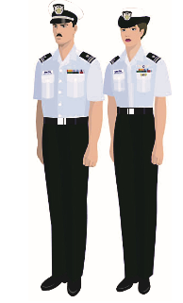
Uniforms
The Auxiliary Manual, Chapter 10, Section A.4 lists uniforms appropriate for the classroom. They include:
Tropical Blue
Winter Dress Blue
Service Dress Blue
Auxiliary Blue Blazer Outfit
See the uniform information available in the Human Resources Website under Auxiliary Uniforms
Notes:
The Auxiliary Manual, Chapter 10, describes the uniforms that are appropriate for the classroom.
There is an excellent uniform presentation on the Human Resources website under Auxiliary Uniforms

Slide 20
Uniforms – Alternative Work Uniform (AWU)
The Chief Director’s Standard Operating Procedure - September 2021.
Authorizes the AWU for PE Classes
Currently in the evaluation process
Available on the Chief Director’s web page under SOPs.
Notes:
The Chief Director’s Office introduced a pilot program via a Standard Operating Procedure in September 2021. The Alternative Work Uniform (AWU) is being test worn in two districts to determine its viability. This pilot program ends December 31, 2022. Even if a member is not in a flotilla in First District Southern Region or Eighth District Coastal Region, they can purchase the uniforms from AUXCEN and are authorized to wear them.
The SOP also states Auxiliarists who participate in activities that often involve multiple Auxiliarists (e.g., public education classes; boat crews; aircrews) may wear the ODU (with or without operations polo shirt), the CG-U, or the Auxiliary Work Uniform (AWU). Hot Weather Uniform (HWU) versions of the ODU and AWU are also authorized for wear if regionally authorized for such activities. For example, members of a boat crew may wear different uniforms on the same patrol. Wearing different uniforms under such circumstances is encouraged in order to help seek and obtain feedback from the public, Coast Guard personnel, and from fellow Auxiliarists about each uniform’s appearance, durability, approachability, and preference.
It further states: The AWU is authorized to be worn as an alternative work uniform whenever the ODU or CG-U is authorized to be worn. This includes authorization to be worn for the purpose of instructing virtual and in-person public education classes, performing boating safety partner visits, and for public outreach events (e.g., boating safety booths at boat shows; public outreach information tables at National Safe Boating Week events). The AWU is specifically not authorized to be worn for ceremonial events (e.g., as part of a color guard; in parade formation).

Slide 21
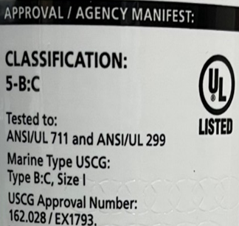
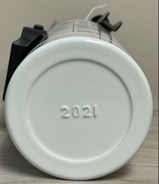
New Material to Cover in Class
Federal Law Change Effective: April 20, 2022 Fire Extinguisher Expiration Dates
Notes:
If a fire extinguisher has a date of manufacture stamped on the bottle (example: “05” means 2005), and it is older than 12-years old, the extinguisher is considered to be expired and must be removed from service. Look for wording on the bottle stating “This product must be removed from service within 12 years after the date of manufacturing”.
All recreational boats are required to carry fire extinguishers if they have permanently installed fuel tank(s) or have spaces that are capable of trapping fumes, such as a boat with
a. a closed compartment under thwarts and seats wherein portable fuel tanks may be stored
b. double bottoms not sealed to the hull or which are not completely filled with flotation material.
c. closed living spaces.
d. closed stowage compartments in which combustible or flammable materials are stowed

Slide 22
Fire Extinguishers
Excellent FAQ at:
https://bit.ly/3Io9v5J

Slide 23
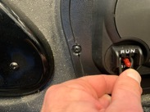
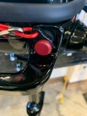
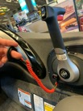
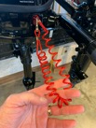
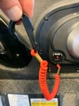
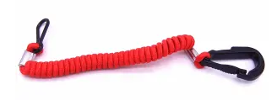
New Material to Cover in Class
Federal Law Change Effective: April 1, 2021 Recreational Boat Engine Cutoff Switch Requirements
Notes:
While statistics are not kept on deaths and injuries related to runaway boats (boats where the occupants are ejected from the vessel while the vessel has propulsion), the USCG has periodically analyzed their data and found dozens of deaths and injuries they believe could have been avoided through the use of engine cut off devices.
The hope is that increased placement of engine shut-off devices, along with continued education will lead more boaters to use these safety devices.
This will put more engine cut-off switches on more small craft which will hopefully reduce deaths and injuries from “circle of death” incidents.

Slide 24
Federal Law Change Effective: April 1, 2021 Recreational Boat Engine Cutoff Switch Requirements
Congress passed two laws:
Manufacturers to install engine cut-off switches on recreational vessels
Recreational vessel operators use the engine cut-off switch
Designed to reduce potential of propeller injuries from runaway boats
Photos courtesy of Dir-V, Jim Cortes
Notes:
During the three years of 2018 to2020, Congress has passed two laws requiring, first, that manufacturers install engine cut-off switches on recreational vessels and, second, that recreational vessel operators use those engine cut-off switches. The laws that have placed these requirements on recreational vessel manufacturers and recreational vessel operators are found in the United States Code (USC), as opposed to the Code of Federal Regulations (CFR) where these types of requirements are typically found. These are federal laws and are not enforceable by state and local marine officers at this time. These new laws will improve safety for all recreational boaters by reducing the potential for propeller injuries to recreational vessel operators, other users of the nation’s waterways, and marine law enforcement officers responsible for responding to runaway boats.

Slide 25
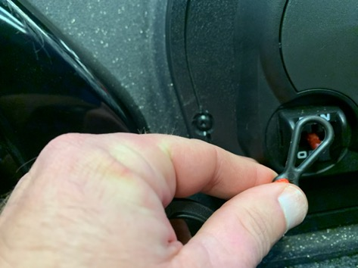
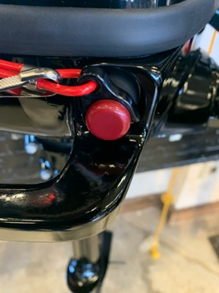
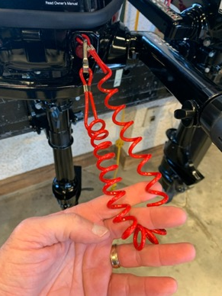
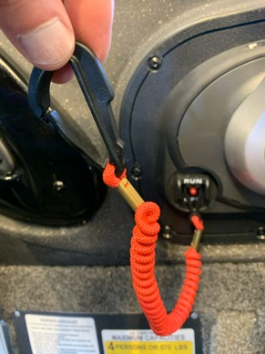
Federal Law Change Effective: April 1, 2021 (Cont’d) Recreational Boat Engine Cutoff Switch Requirements
Specifics:
Applies to recreational vessels under 26’ capable of 115 pounds of thrust
Act requires manufacturer, distributor or dealer of those vessels or motors to equip them with the ECOS
Photos courtesy of Jim Cortes, DIR-V
Notes:
More specifically, Section 503 of the LoBiondo Coast Guard Authorization Act of 2018 created 46 USC 4312 to require a manufacturer, distributor, or dealer that installs propulsion machinery and associated starting controls on a covered recreational vessel (less than 26 feet long and capable of 115 pounds of static thrust) to equip the vessel with an ECOS per compliant with ABYC Standard A-33. This law went into effect on December 4, 2019 one year after the 2018 CGAA was enacted and is referred to as the “installation requirement.”

Slide 26
Federal Law Change ECOS; April 1, 2021 (Cont’d)
Operator of a vessel covered by new law MUST use the ECOS, except:
If main helm is in enclosed cabin
If vessel doesn’t have an ECOS
If vessel doesn’t require one
Penalty for non-compliance
1st offense: $100 fine
2nd offense: $250 fine
3rd offense: $500 fine
Notes:
Section 8316 of the National Defense Authorization Act of 2021 amended 46 USC 4312 to require individuals operating those recreational vessels covered by the installation requirement to use ECOS links, except if the main helm is within an enclosed cabin or the vessel does not have and is not required to have an ECOS. It provides a penalty of $100, $250, and $500 for the first, second, and third offenses, respectively. The law went into effect on April 1, 2021. This requirement is referred to as the “use requirement.”

Slide 27
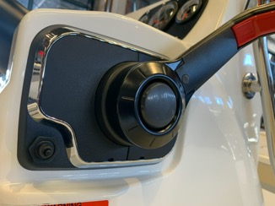
Federal Law Change Effective: April 1, 2021 (cont’d) Recreational Boat Engine Cutoff Switch Requirements
The law went into effect on April 1, 2021.
These seven States have ECOS laws:
• Alabama
• Arkansas
• Illinois
• Louisiana
• Nevada
• New Jersey
• Texas
Photos courtesy of Jim Cortes, Dir-V
Notes:
The seven States listed have ECOS laws:
• Alabama
• Arkansas
• Illinois
• Louisiana
• Nevada
• New Jersey
• Texas
The Coast Guard will be contacting those states to discuss those laws this coming month. Federal law preempts States from enacting or enforcing a law on a subject that is different from federal law on the same subject.
However, the Coast Guard has the authority to provide an exemption from preemption if recreational vessel safety is not adversely affected, as when a state law is close enough to the federal law and does not adversely affect recreational vessel safety.

Slide 28
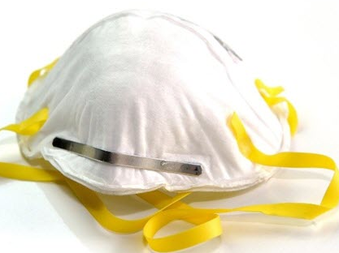
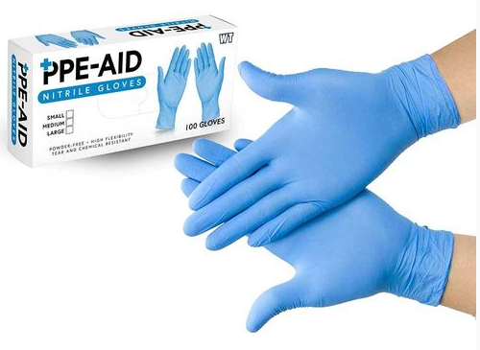
COVID-19 Guidelines
The current information (January 5, 2022) is contained in ALAUX 01-22-Chief Director’s site
This is Version 3 of COVID guidance
Requires full COVID-19 vaccination for Coast Guard Auxiliarists when assigned to duty that involves in-person interaction
Districts and/or Sectors may require additional PPE such as masks and gloves
Notes:
COVID-19 Guidance is found on the Chief Director’s website on the left side menu under ALAUX. It is also excerpted below.
05 JAN 2022
FM: CHDIRAUX
TO: ALAUX
ALAUX 001/22
Subj: AUXILIARY COVID-19 RECONSTITUTION GUIDANCE - VERSION 3
This update incorporates change, effective immediately, that requires full COVID-19 vaccination for Coast Guard Auxiliarists when assigned to duty that involves in-person interaction with Coast Guard personnel (including other Auxiliarists), other government personnel (federal, state, and local), or members of the public. It is meant to ensure the health and well-being of unvaccinated Auxiliarists, Coast Guard personnel, and members of the public that the Coast Guard is obligated to protect. Unvaccinated Auxiliarists (including partially vaccinated) remain able to volunteer for any assignments or activities that do not involve in-person interaction with members of the public, other government personnel, or Coast Guard personnel.
This guidance is intended to provide assistance to the Directors of Auxiliary (DIRAUX), Coast Guard units, and Order Issuing Authorities (OIA) on how to use Coast Guard Auxiliarists in the safest way possible during the COVID-19 Pandemic. Knowing that the spread of the Pandemic is different in every area, region, state, city, town, etc., DIRAUX and OIAs may deviate from this guide as they see fit for their cognizant areas of responsibility (AOR), except for the vaccination requirement.

Slide 29
E-Directorate Contacts
Director: David Fuller
Deputy: Robert Brandenstein
Division Chief-Course Development: Gregory Fonzeno
Division Chief-Course Management: COMO Michael Morris
Division Chief-Communication Services: Dan Stroup
Division Chief-Instructor Development: Karen Miller
Contact info available in AuxDirectory
https://auxofficer.cgaux.org/auxoff/index.php

Slide 30
Thank You
If any questions, contact the appropriate E-Directorate Staff
following the Chain of Leadership and Management
You may email the E-Directorate at
pe.feedback@cgauxnet.us
Notes:
It’s the policy of the CG Auxiliary that we solve issues at the lowest level. If the problem, question, or issue cannot be handled at this lower level, follow the Chain and press the issue higher.
All issues should be solved at the lowest possible level and elevated as needed through the chain of leadership and management to have the issue addressed. It is NOT appropriate to go outside our organization for answers to education-related issues unless specifically instructed by the staff of the Education Directorate. Inquiries posed outside our organization confuse our partners and delay a proper response.
The entire staff of the E Directorate is standing by to answer any education questions that cannot be answered at a lower level.
The E-Directorate also maintains a feedback email address to assist members with answers they could not find anywhere else within the Auxiliary.
It is very important that members understand that they are not to contact the Chief Director’s office or anyone outside of the CG Auxiliary Chain of Leadership and Management. Any requests outside the Chain unnecessarily tie up resources answering these questions at BSX, NASBLA, and the BLA offices for internal Auxiliary queries. At the very least, it paints the Auxiliary as undisciplined and unable to communicate internally. At worst, it threatens our credibility at a national level with these national partners which can have important ramifications on future relationships.

Slide 31
REMINDER
Submit your self-attestation form if you studied this workshop outside of a facilitated session.

